Slide 1
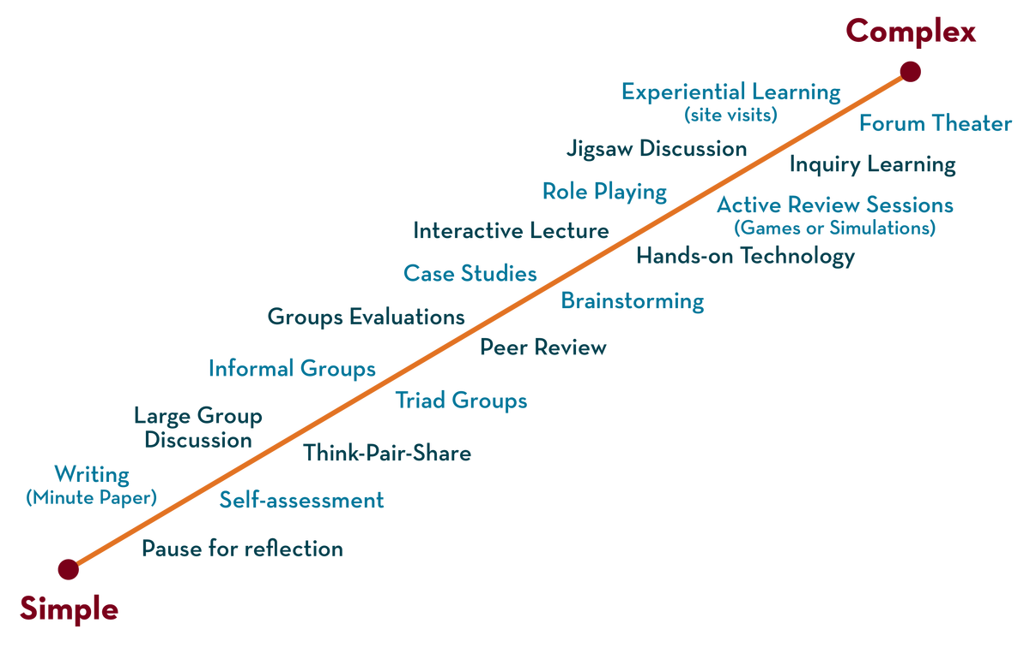
Department of ECE
ANALOG ELECTRONIC CIRCUIT DESIGN 22EC2104A
CO-4
Session-4 metal oxide semiconductor field effect transistor (MOSFET): – enhancement mode

Slide 2





AIM OF THE SESSION
To familiarize students with the MOSFET Construction and operation in enhancement mode
INSTRUCTIONAL OBJECTIVES
This Session is designed to:
Give introduction MOSFET
To analysis operation of MOSFET in enhancement mode
LEARNING OUTCOMES
At the end of this session, you should be able to:
1. Describe the working principle of MOSFET.
2. Demonstrate the applications of MOSFET circuits

Slide 3
INTRODUCTION
A MOSFET (Metal-Oxide-Semiconductor Field-Effect Transistor) is a fundamental semiconductor device used in modern electronics. It consists of a gate, source, and drain terminals.
The key feature of a MOSFET is its ability to control the flow of current through a channel by applying a voltage to the gate terminal.
The gate voltage determines the conductivity of the channel, allowing or blocking the flow of current between the source and drain.
MOSFETs offer advantages like high switching speed, low power consumption, and scalability, making them essential in integrated circuits for applications ranging from digital logic to power amplification.

Slide 4
MOSFET
The most common type of insulated gate FET which is used in many different types of electronic circuits is called the Metal Oxide Semiconductor Field Effect Transistor or MOSFET for short.
The IGFET or MOSFET is a voltage controlled field effect transistor that differs from a JFET in that it has a “Metal Oxide” Gate electrode which is electrically insulated from the main semiconductor n-channel or p-channel by a very thin layer of insulating material usually silicon dioxide, commonly known as glass.
This ultra thin insulated metal gate electrode can be thought of as one plate of a capacitor. The isolation of the controlling Gate makes the input resistance of the MOSFET extremely high way up in the Mega-ohms ( MΩ ) region thereby making it almost infinite.

Slide 5
Cont…
The main difference this time is that MOSFETs are available in two basic forms:
Depletion Type – the transistor requires the Gate-Source voltage, ( VGS ) to switch the device “OFF”. The depletion mode MOSFET is equivalent to a “Normally Closed” switch.
Enhancement Type – the transistor requires a Gate-Source voltage, ( VGS ) to switch the device “ON”. The enhancement mode MOSFET is equivalent to a “Normally Open” switch. The symbols and basic construction for both configurations of MOSFETs are shown below.

Slide 6
Cont…
The four MOSFET symbols above show an additional terminal called the Substrate and is not normally used as either an input or an output connection but instead it is used for grounding the substrate.
It connects to the main semiconductive channel through a diode junction to the body or metal tab of the MOSFET. Usually in discrete type MOSFETs, this substrate lead is connected internally to the source terminal.
When this is the case, as in enhancement types it is omitted from the symbol for clarification.

Slide 7
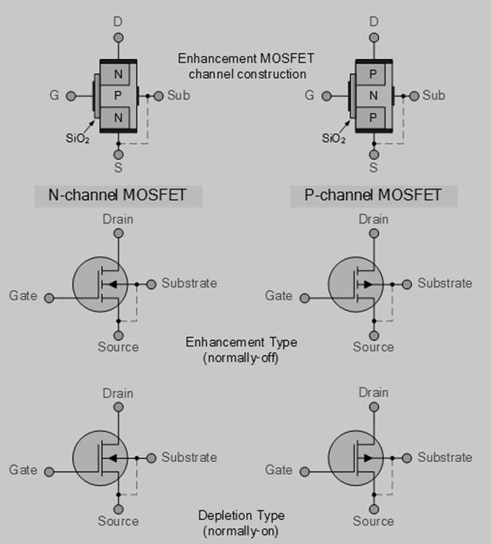
Cont…
The line in the MOSFET symbol between the drain (D) and source (S) connections represents the transistors semiconductive channel. If this channel line is a solid unbroken line then it represents a “Depletion” (normally-ON) type MOSFET as drain current can flow with zero gate biasing potential. If the channel line is shown as a dotted or broken line, then it represents an “Enhancement” (normally-OFF) type MOSFET as zero drain current flows with zero gate potential. The direction of the arrow pointing to this channel line indicates whether the conductive channel is a P-type or an N-type semiconductor device.

Slide 8
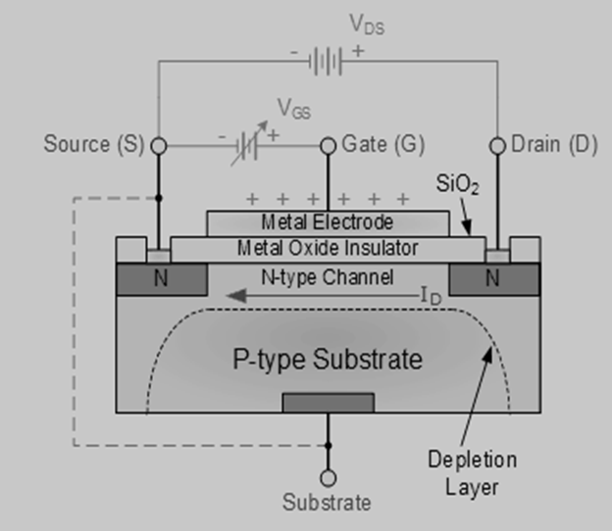
Basic MOSFET structure and symbol
The construction of the Metal Oxide Semiconductor FET is very different to that of the Junction FET.
Both the Depletion and Enhancement type MOSFETs use an electrical field produced by a gate voltage to alter the flow of charge carriers, electrons for n-channel or holes for P-channel, through the semiconductive drain-source channel.
The gate electrode is placed on top of a very thin insulating layer and there are a pair of small n-type regions just under the drain and source electrodes.

Slide 9
Cont…
The gate of a junction field effect transistor, JFET must be biased in such a way as to reverse-bias the pn-junction.
With a insulated gate MOSFET device no such limitations apply so it is possible to bias the gate of a MOSFET in either polarity, positive (+ve) or negative (-ve).
This makes the MOSFET device especially valuable as electronic switches or to make logic gates because with no bias they are normally non-conducting and this high gate input resistance means that very little or no control current is needed as MOSFETs are voltage controlled devices.
Both the p-channel and the n-channel MOSFETs are available in two basic forms, the Enhancement type and the Depletion type.

Slide 10

SUMMARY
An enhancement-mode MOSFET is a type of metal-oxide-semiconductor field-effect transistor that operates in an "off" state without a voltage bias applied to the gate terminal.
It requires a positive voltage at the gate relative to the source terminal to turn "on" and allow current flow.
This makes it suitable for use as a switch or amplifier in electronic circuits. The device features a thin insulating layer (oxide) between the gate and channel, enabling precise control over the transistor's conductivity.
By applying an appropriate voltage to the gate, the MOSFET enhances the channel's conductivity, facilitating efficient signal amplification or switching operations.

Slide 11
SELF-ASSESSMENT QUESTIONS
1. Enhancement mode MOSFET is typically operated in which region?
a) Saturation region
b) Linear region
c) Cutoff region
d) Breakdown region
2. The channel in an enhancement mode MOSFET is formed by:
a) N-type material
b) P-type material
c) Intrinsic material
d) Insulating material

Slide 12
TERMINAL QUESTIONS
Draw the structure of n channel enhancement mode MOSFET
Explain the operation of enhancement mode MOSFET

Slide 13
REFERENCES FOR FURTHER LEARNING OF THE SESSION
Reference Books:
1. Jacob Millman - “Electronic Devices and Circuits”, 4th Edition, McGraw Hill Education (2015)
2. D Roy Choudhury and Shail B. Jain – “Linear Integrated Circuits”, 4th Edition, New Age International Pvt.Ltd. (2017)
3. David A. Bell - “Electronic Devices and Circuits”, 5th Edition, Oxford University Press (2008)
Sites and Web links:
https://www.learnelectronicswithme.com/2020/07/what-is-jfet-construction-and-working.html
https://electronicspost.com/explain-the-construction-and-working-of-a-jfet-what-is-the-difference-between-a-jfet-and-a-bjt/
https://electronicsdesk.com/junction-field-effect-transistor.html

Slide 14
THANK YOU
Team – ANALOG ELECTRONIC DEVICES AND CIRCUITS

